Slide 1
SQL Project
GROUP - 5
Fareedha, Jithu, Priyanka, Radhika, Shyma, Stacy, Suhana,Twinkle

Slide 2
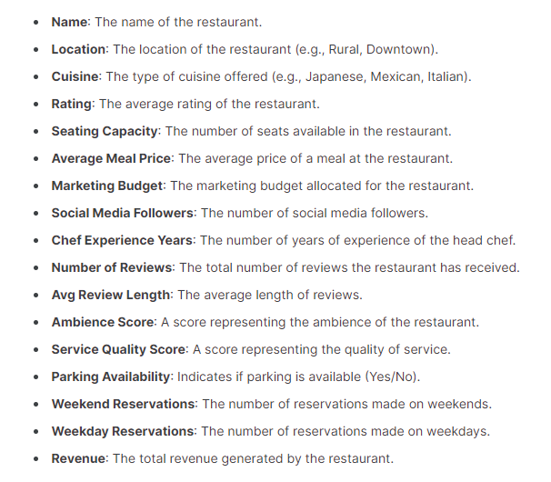
DATASET INFORMATION
Source: Kaggle
Name: Restaurant data
Number of rows: 8368
Number of columns: 17 (1 added)

Slide 3
Objective
The objective is to analyze the restaurant data using SQL. It includes,
Find factors influencing revenue of restaurants and optimize restaurant performance.
Understand customer preferences and behaviors thereby improving customer satisfaction and personalize marketing strategies.
Analyze customer reviews and feedback to enhance customer experience and address issues promptly.
Analyze trends in sales.

Slide 4
SQL queries and findings
-- add a column 'Revenue in Millions'
alter table restaurant_data add column `Revenue in Millions` double;
set sql_safe_updates=0;
update restaurant_data set `Revenue in Millions`= round((Revenue/1000000),2);
select location,count(location) from restaurant_data group by location order by location;
-- There are 3 different types of locations: Downtown(2821), Rural(2762), and Suburban(2785).
2. select cuisine from restaurant_data group by cuisine;
-- There are 6 different type of cuisines: Indian, Japanese, Mexican, French, Italian, and American.
3. select cuisine,count(cuisine) as No from restaurant_data group by cuisine order by No desc;
-- French cuisine is the highest in number(1433) and the least is Japanese(1344)
4. select location,cuisine,count(cuisine) as cuiscount from restaurant_data group by location,cuisine order by location,cuiscount desc;
In Downtown, most number of cuisines are American(494) and the least is Japanese(433)
In Rural area, French cuisines(499) are the most and the least are Indian cuisines(431)
In Suburban area, Indian cuisines are most(489) and the least are Japanese(426)

Slide 5
5. select location,cuisine,avg(rating) as avg from restaurant_data group by location,cuisine order by location, avg desc;
-- French cuisine has the highest average rating in Downtown area, Italian in Rural area and Indian cuisine in suburban area.
6. select location,cuisine,round(avg(`seating capacity`),0) as seating from restaurant_data group by cuisine,location order by location, seating desc ;
-- Average seating capacity in Downtown in 80, Rural is 40 and Suburban is 60
7. select cuisine,max(`average meal price`),min(`average meal price`) from restaurant_data group by cuisine;
-- max average meal price is 76 for Japanese cuisine and min average meal price is 25 for Mexican cuisine.
8. select location,cuisine,max(`social media followers`) as Most_Followers from restaurant_data group by location, cuisine order by location, Most_Followers desc ;
-- Most followers in Downtown is for French cuisine(103777), -- in Rural is for Japanese cuisine(58082), -- in Suburban is for Indian cuisine(57233)
9. select * from restaurant_data order by `social media followers` desc;
-- downtown location has most social media followers. Suburban and rural locations have comparitatively less socail media followers.
10. select location,cuisine, `marketing budget` from restaurant_data order by `marketing budget` ;
-- Marketing budget is high in downtown and low in suburban and rural areas.

Slide 6
11. select cuisine,min( `marketing budget`),max(`marketing budget`) from restaurant_data group by cuisine ;
-- maximum marketing budget is for Mexican cuisine(9978) in downtown location and minimum marketing budget is for Japanese cuisine(604) in suburban location.
12. select location,cuisine,max(`marketing budget`) as max_marketing_budget from restaurant_data group
by location, cuisine order by location,max_marketing_budget desc;
-- Mexican cuisine has the most marketing budget in downtown location(9978) and Suburban locations(4980),whereas Japanese cuisine has the most marketing budget in Rural location(4871)
13. select location,cuisine,avg(`number of reviews`) as avg from restaurant_data group by location,cuisine order by location, avg desc;
-- average number of reviews is high for French cuisine(539.26) in downtown location, italian cuisine(541.40) in rural location and Indian cuisine(531.50) in suburban location.
14. select location,count(location) from restaurant_data where `parking availability`='yes' group by location
order by location;
-- Regarding the parking availability, in Downtown out of 2821, 1426 restaurants have parking availability(50.549%) whereas it is 1379 out of 2762 in Rural location (49.9275%) and in Suburban area, 1384 restaurants have parking facility out of 2785 restaurants(49.6947%).

Slide 7
15. select location,cuisine,avg(`Weekend Reservations`) as Reservation from restaurant_data group by
location,cuisine order by location, Reservation desc;
select location,cuisine,sum(`Weekend Reservations`) as Reservation from restaurant_data group by
location,cuisine order by location, Reservation desc;
-- Highest weekend reservation In Downtown is for Italian cuisine(average is 40.41) and the least is
for Japanese(37.02).
-- In rural area the highest weekend reservation is for Indian(19.64) and lowest for Mexican(19.05).
-- In Suburban area, the highest is for Japanese(30.05) and lowest is for Italian (28.86)
16.select location,avg(`weekday reservations`) FROM restaurant_data group by location ;
-- average weekday reservations is high in downtown and low in rural
17. select * FROM restaurant_data order by revenue desc ;
-- high revenue is generated in downtown location for Japanese cuisine(1.53M) and low in rural location for mexican cuisine(0.18M)

Slide 8
Conclusion
The analysis provides a comprehensive view of the performance and customer preferences across 8,368 restaurants in Downtown, Rural, and Suburban areas.
Restaurant 4324 in Downtown emerged as the most revenue-generating establishment. Overall, 3,566 restaurants performed above average. Downtown was the highest revenue-generating area, bringing in $2,445 million. Among the cuisines, Japanese cuisine led with $1,260 million in revenue, while Mexican cuisine generated the least revenue of $596 million.
We found out that the factors that influence the revenue are location, cuisine type, average rating, seating capacity, meal price, number of social media followers and marketing budget. All the factors are directly proportional to revenue of restaurant.
Most customers opted for french cuisine. Also the average rating , number of reviews and social media followers increased the popularity for french cuisine. Less customers opted for Japanese cuisine because of its high price.

